Slide 1
TOK: AOK’s
Math

Slide 2
Overview of Lesson
What is Math?
Key Definitions in Math
Video:
“Is Math Invented or Discovered?”
Discussion
Self-Reflection

Slide 3
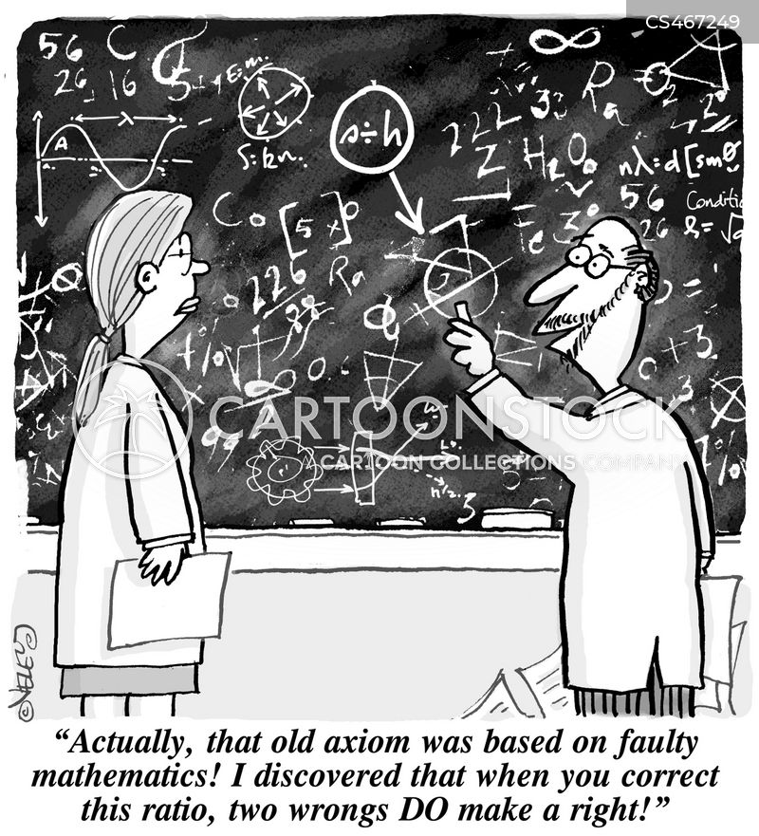
Axiom
A self-evident truth which requires no proof
A universally accepted principal or rule
A proposition which is assumed without proof to assess the consequences

Slide 4
Euclid’s Axioms:
1. You can draw a straight line between any two points
2. It is possible to produce extend a finite line segment into a straight line
3. It is possible to construct a circle of given radius and centre
4. All right angles are equal to one another

Slide 5
Theorem and Conjecture
Pythagoras’ Theorem: “In a right angled triangle the square of the hypotenuse is equal to the sum of the squares of the other two sides”
A statement that has been proven with logical arguments based on axioms
Goldbach’s Conjecture: “it seems that every number that is greater than 2 is the sum of three primes”
A statement that needs proof to be accepted

Slide 6
Proofs
Mathematical Proof must have a starting point something that is assumed to be true(axioms)
Mathematical Proof follows logical structure and reasoning
There are many different approaches, each proof can be unique sometimes requiring imagination, visualisation and creative
The process of logical reasoning and proof can generate new knowledge and understanding purely through thinking

Slide 7
Algorithms

Slide 8
Is Math invented or discovered?
While watching fill in your chart with thinkers or examples from both sides of the debate.
https://www.youtube.com/watch?v=X_xR5Kes4Rs&t=1s

Slide 9
Self Reflection
Choose one of the following and write a SHORT response with specific examples to support your position. Indicate your selection at the top of your page.
Is Math invented or discovered?
How do we attain certainty when using Math?
Are visual representations always helpful in the communication of knowledge?

