Slide 1
TOK: AOK’s
Human Sciences

Slide 2
Overview of Lesson
What are the Human Sciences?
Do disciplines in Human Sciences create greater knowledge?
The Scientific Method in the Human Sciences
Growth vs Fixed Mindset
Quiz

Slide 3
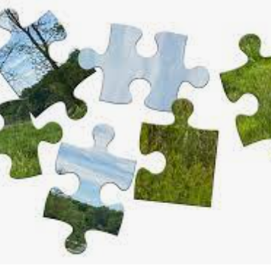
What are the Human Sciences?
This AOK seeks explanations for the human condition; our existence, our behaviours, our function and our systems.
Characterized by the process of humans studying humans
Anthropology, economics, geography, linguistics, media studies, political science, psychology, sociology
Notes:
-To what extent are survey results consistent and reliable?
-A discipline can be a part of this AOK if its methodologies are said to be scientific
-perspectives creates disciplines within each field…for example, psychology can be split into many disciplines (social, cognitive, biological, abnormal, personality, forensic)

Slide 4
Does the division of knowledge into discrete disciplines create greater understanding?
Do you agree or disagree with this knowledge question?

Slide 5
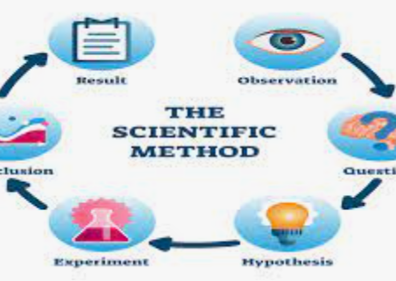
The Scientific Method in the Human Sciences?
In the human sciences, quantitative methods used are laboratory experiments, field experiments, natural experiments, quasi experiments, correlational studies
https://www.youtubeeducation.com/watch?v=QLP9aTSDd14
Notes:
-Listening to classical music helps IQ scores

Slide 6
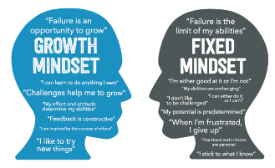
Growth vs Fixed Mindset
Growth Mindset – the belief that intelligence and talent can be developed with practice and effort
Fixed Mindset – the belief that intelligence, talent, and other qualities are innate and unchangeable

Slide 7
Growth vs Fixed Mindset?
https://www.idrlabs.com/growth-mindset-fixed-mindset/test.php

Slide 8
Stanford Prison Experiment
https://www.youtubeeducation.com/watch?v=760lwYmpXbc

Slide 9
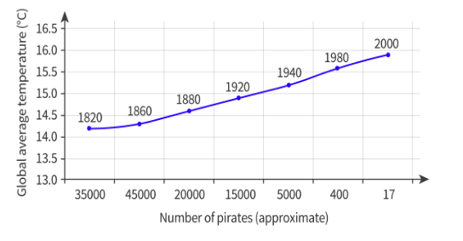
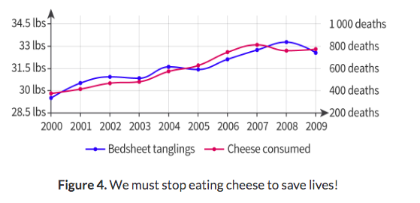
Other Factors for Human Sciences
Bias – the way the data is collected can bias the results
Ethics – Similar with the Stanford Prison Experiment, human experimentation can bring up personal ethics and moral dilemmas for those conducting the experiments
Some experiments have results that do not make sense or that are not important

Slide 10
Self Reflection
Choose one of the following and write a SHORT response with specific examples to support your position. Indicate your selection at the top of your page.
Is human behaviour too unpredictable to study scientifically?
How do human scientists give knowledge meaning through the telling of stories?
Avoiding bias seems a commendable goal, but this fails to recognize the positive role that bias can play in the pursuit of knowledge.

