Slide 1
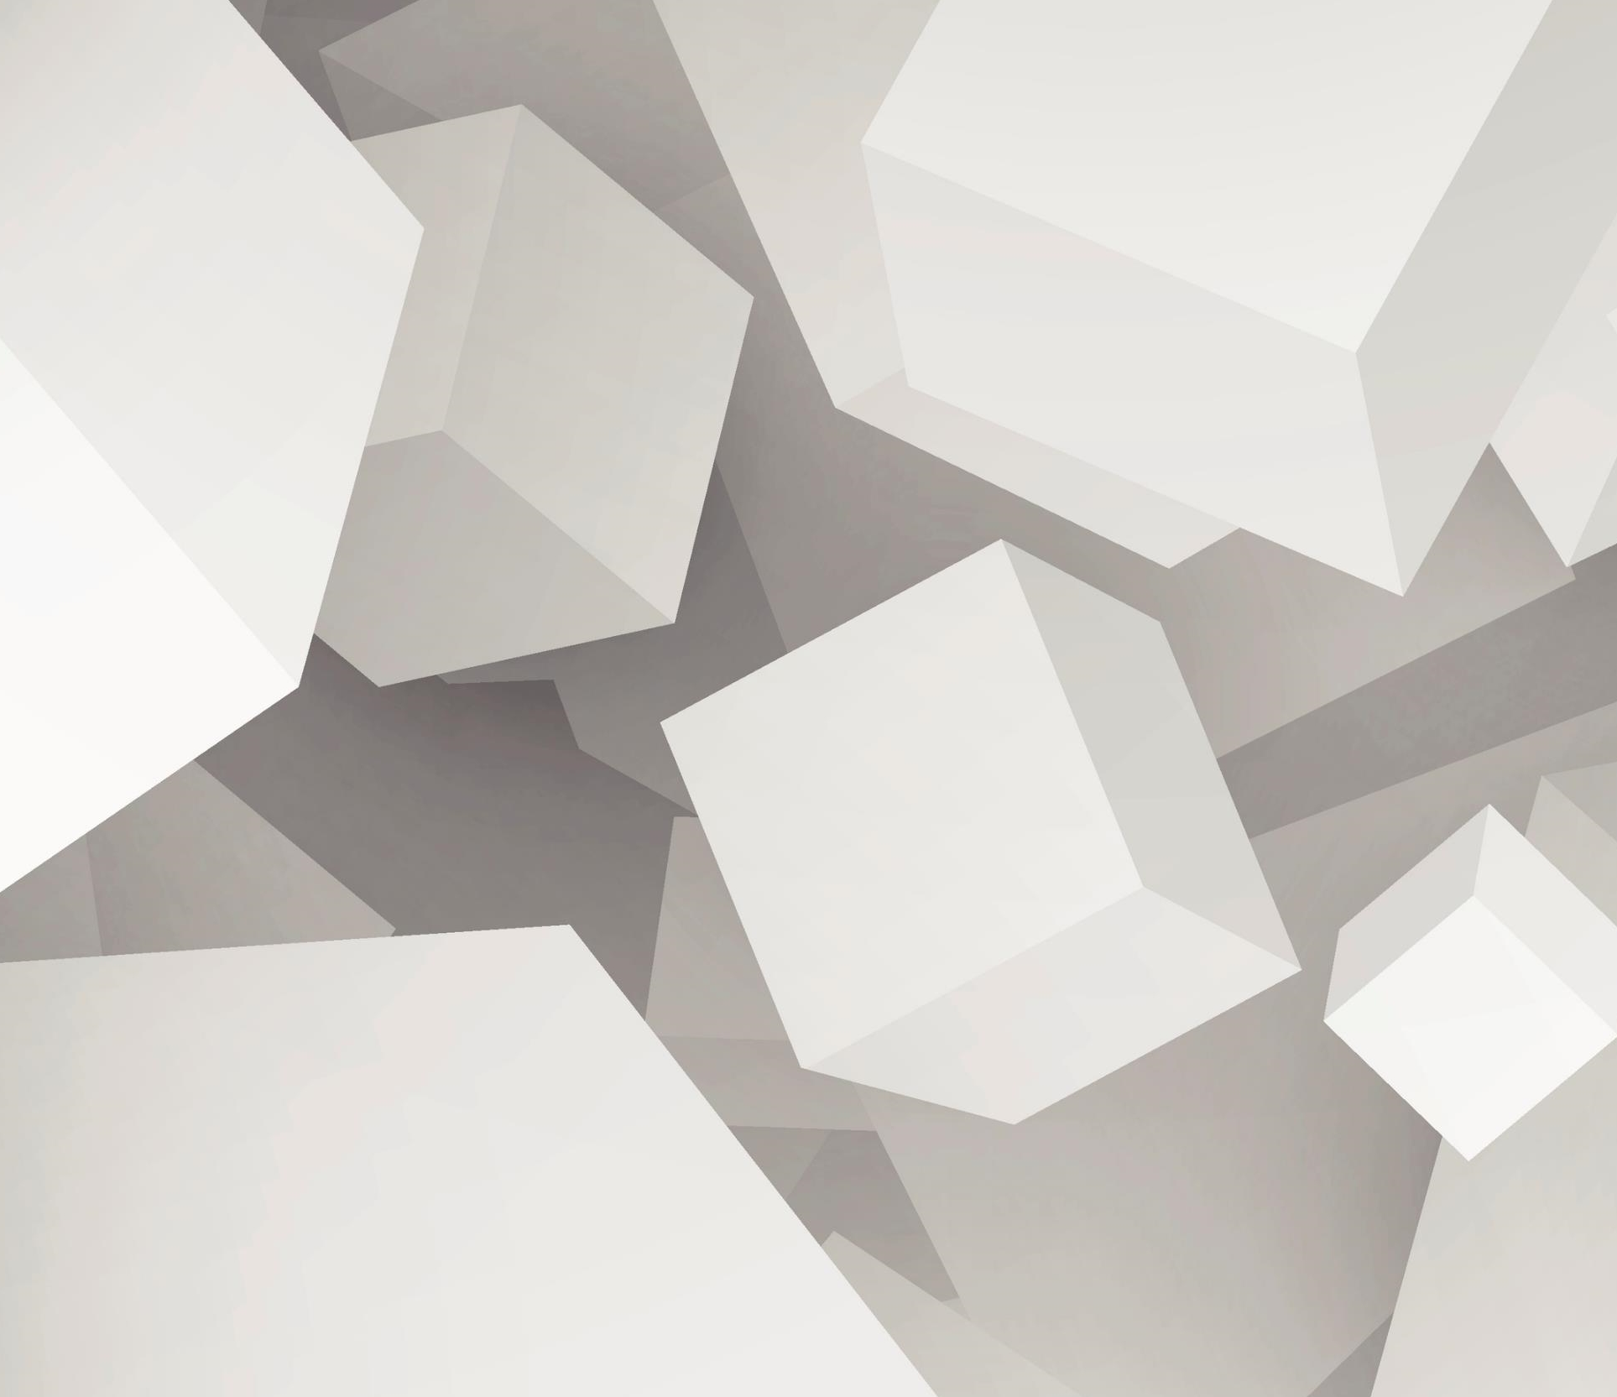
TOK: AOK’s
Art

Slide 2
Overview of Lesson
What is Art?
What Type of Knowledge Does Art Create?
Perspectives in Art
Video:
“Using Art to Turn the World Inside Out”
Discussion

Slide 3
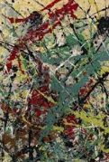
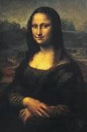
What is Art?
By definition: the expression or application of human creative skill and imagination, typically in a visual form producing works to be appreciated primarily for their beauty or emotional power
Notes:
-very personal and can be frustrating due to the shortage of clear answers
-Are sports art?
-Jackson Pollock piece
-placing a brick in a room…is that art?
-ask why did they do that?

Slide 4
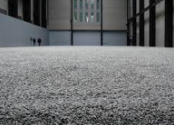
What Type of Knowledge Does Art Create?
While other AOK provide the arts with much of their raw materials of knowledge, you can argue that the arts emphasise the significance of that knowledge
Tesselation Art…is it art or math or both?
Many artists have been censored, imprisoned or even killed by governments
Notes:
-Burmese singer, Win Maw, arrested in 2007 as lyrics deemed subversive and imprisoned for 5 years
-Chinese artist Ai Weiwei-porcelain sunflower seed husks symbolise China’s factory workers who are often treated as insignificant

Slide 5
Perspectives in Art
Perspectives in the arts are everything
Articulates the perspective of the artist(s), and the existing perspectives held by the individual who experiences the art
Sometimes the perspectives of the artists are obvious, but others are not
Experts in the arts include gallery owners, museum directors, exhibition curators, media critics, other artists, and art historians

Slide 6
Does Knowledge Within the Arts Increase in Quality Over Time?
Some experts say art is not a function of time as a number of works of art “stand the test of time”
For example, Shakespeare plays, the Mona Lisa by Leonardo DaVinci
Culture plays a role

Slide 7
Can Art Change the World?
https://youtu.be/0PAy1zBtTbw

Slide 8
Self- Reflection
Choose one of the following and write a SHORT response with specific examples to support your position. Indicate your selection at the top of your page.
Can a work of art have meaning of which the artist themselves is unaware?
Does art enlarge what it is possible for us to think and know?
How can we distinguish between good and bad interpretations?

